Slide 1
SMART APP FOR AIRPORT FEEDBACK
BY
SHASHANK VARSHNEY(19ESKIT086)
SHIVAM THAKKAR(19ESKIT087)
SUJAL SOMANI(19ESKIT092)
YUVRAJ GAKKHAR(19ESKIT100)
SUPERVISED BY Ms. DOLLY MITTAL

Slide 2
PRESENTATION OUTLINE
01
02
03
PURPOSE
INTRODUCTION
EXISTING SYTEM

Slide 3
PRESENTATION OUTLINE
04
05
06
PROPOSED SYSTEM
SCOPE
SYSTEM REQUIREMENTS

Slide 4
PRESENTATION OUTLINE
07
08
09
USER CHARACTERSTICS
TECHNOLOGIES USED
CONSTRAINTS

Slide 5
PRESENTATION OUTLINE
10
11
12
PROJECT SCREENSHOTS
FUTURE SCOPE
MODULES
REFERENCE

Slide 6
Introduction
Using digital feedback software, airport management can hear the voice of each passenger - about airport staff, airport amenities, and general passenger perception about the airport and the flights. It gives you platform to recognize key trends, track repetitive issues and resolve them faster than before. Through our Airport Feedback App, airport management can get 100% more passenger feedback at airports and in airlines, and that too in real-time
We have also included visual representations of all the surveys through which it will be easier for the airport management team to understand the survey results. We learned that whenever we want to solve a problem the best way is to look for the solutions around us. We also learned how to work in a team and make use of online project

Slide 7
Purpose
Using digital feedback software, you can hear the voice of each passenger - about airport staff, airport amenities and general passenger perception about the airport and about the flights. It gives yaou a platform to recognize key trends, track repetitive issues and resolve them faster than before.
100% more passenger feedback at airports and in airlines Real-time passenger feedback Resolve passenger issues faster than before Track staff and teller performance at airports and airlines Compare passenger satisfaction different touch-points Improve passenger delight and happiness

Slide 8
Existing System
The available systems has only printed forms and they need to be filled physically using pen or pencil and some of the online forms doesn't have department specific feedback forms. They just display a single feedback form which includes all the departments.

Slide 9
Proposed System
The proposed system is intranet based system so passengers can also participate in viewing their belongings.
The proposed provides detail general information about the passengers along with their personal/basic information and their arrival and destination places.

Slide 10
Proposed System
At a conceptual level, there may be many different kinds of objects within a given site that are accessible to users. At the physical level, these objects may be represented by one or more Web pages. Conceptually, each of these entities represents a different type of semantic object. During a visit to this site, a user may access several of these objects together during a session.
contrast to content features, ontological representation of domain knowledge contained in the site makes it possible to have a uniform architecture to model such objects, their properties, and their relationships. In this section we will present a general framework for fully utilizing domain ontologies in Web usage mining and personalization.

Slide 11
Scope
Airport Feedback App helps the staff in doing everything they can to make the journey less stressful. The real-time feedback system has expanded to allow passengers to rate lounges, staff, store, etc., in addition to the cleanliness of facilities. Prime focus on actionable insights has led to increased airport productivity. This has refined the service standards for better passenger experience.
Our project aims at Business process automation, i.e. we have tried to computerize various processes of Airport Feedback App

Slide 12
System Requirements
The system will allow access only to authorized users with specific roles (Passengers, Administrator etc.). Depending upon the user's role, he/she will be able to access only specific modules of the system.
A summary of the major functions that the software will perform:
A Login facility for enabling only authorized access to the system.
Passenger can view their flight details and can give feedbacks.
Admin can view feedbacks summary and feedback messages

Slide 13
User Characteristics
Educational Level: User should be at least graduate and comfortable with English.
Experience: User should be well versed / informed about the structure of the program.
Technical Expertise: User should be comfortable using general purpose applications on a computer

Slide 14
Constraints
Since the DBMS being used in this project is MongoDB, and the web server is Node Server, that are free open source tools, the server technologies are out of any guarantees,unless specifically purchased for enterprise environment.
Due to limited features of DBMS being used, performance tuning features will not be applied to the queries and thus the system may become slow with the increase of data records being stored.
Due to limited features of DBMS, database auditing will also not be provided.
As the application runs over a network environment, well documented security policy is required to prevent and safeguard data as well as services over the network.

Slide 15
Assumption & Dependencies
The number of domains being selected by the user does not change.
The project Code will not change.
The number of modules assigned to employee cannot be changed.

Slide 16
Technologies Used
Application Architecture(MERN Stack): MongoDB, Express, Node, React
Development Tool: Visual Studio Code
Version Control: Git/GitHub
Deployment: Vercel
Design Tool: Creatly

Slide 17
System Architecture
System architecture presents the schematic view of the complete system along with its major components and their connectivity.
The overall architecture of the proposed system will be as follows.

Slide 18
Modules
Module 1 - Passenger
Module 2 – Feedback Forms
Module 3 – Admin
Module 4 – FeedBack Management

Slide 19
Module - 1:
Passenger:
This is the other user page, i.e. the passenger page after login.
This is the passenger dashboard, passenger can use it to navigate to different section
of the website and they can also view their flight details like airline name. Aircraft
name, flight departure date and time, flight arrival date time, etc. on this page.

Slide 20
Module - 2:
Feedback Forms :
This page shows 8 different departments of the airport for which
a passenger can give their feedback.
The 8 different departments are:
• Food Court
• Baggage
• Check In
• Help Desk
• Airlines
• Lounges
• Stores
• Washroom

Slide 21
Module - 2:
Feedback Form Page:
After selecting the department in feedback page the passenger in redirect to the re-
spective feedback form of that department and the passenger here can give their
feedbacks based on different services or parameters between 0.5 and 5. They can
also give the feedback message for the respective department.

Slide 22
Module - 3:
Admin:
This page is the first page after login a manager will see.
Feedback Page:
This page is the same as the one in passenger module. It also has the same 8 de-
partments but when the admin clicks on it, he will be able to view the results to
feedbacks given by the passengers.

Slide 23
Module - 4:
Feedback Management:
This displays the feedbacks summary of the respective department in the form ofcircular progress bar. This also displays the entire feedback message given by thepassengers.Mail is sent to user after successfull feedback submitition
The overall objective of Feedback Management is the development of database technology has been to treat data as an organizational resource and as an integrated whole. DBMS allow data to be protected and organized separately from other resources.
The organization of data in database aims to achieve three major objectives:
• Data integration.
• Data integrity.
• Data independence.

Slide 24
Use Case
Airport Feedback App has two actors
Passenger:Passenger can give the feedback regarding the different departments such as airlines, check- in counter, food court, help desk, lounge, store, etc.
Admin:Admin has the authority to view or access the feedback provided by the passengers. Admin can also perform different types of operations on the feedback provided by the passengers to conclude different results

Slide 25
Test Case
Execution Test Summary Report is an overall view of Testing Process from start to end. Test Plan comes at the starting of project while Test Summary Report comes at the end of testing process. This report is given to the client for his understanding purpose.
The Test Summary Report contents are:
Test Case ID generated = PRO1, PRO22.
Total number of resources consumed = 23.
Passed Test Cases = 24.
Failed Test cases = 05.
Status of Test Cases = Passed

Slide 26
Screenshots

Slide 27
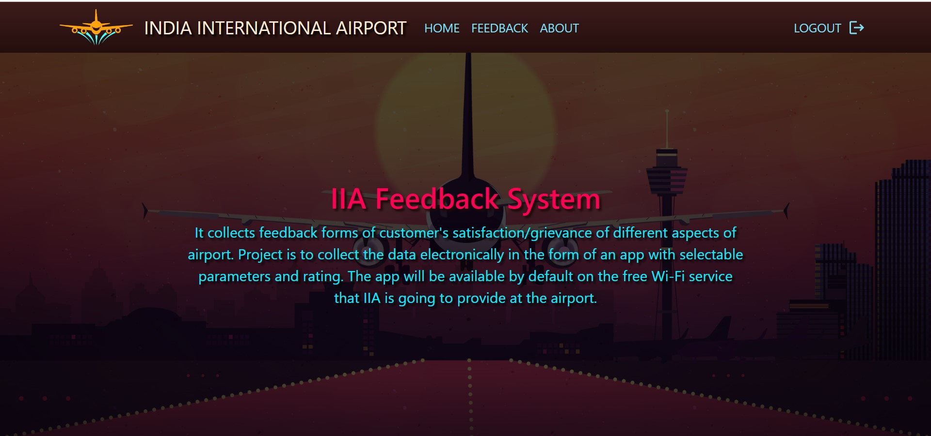
About

Slide 28
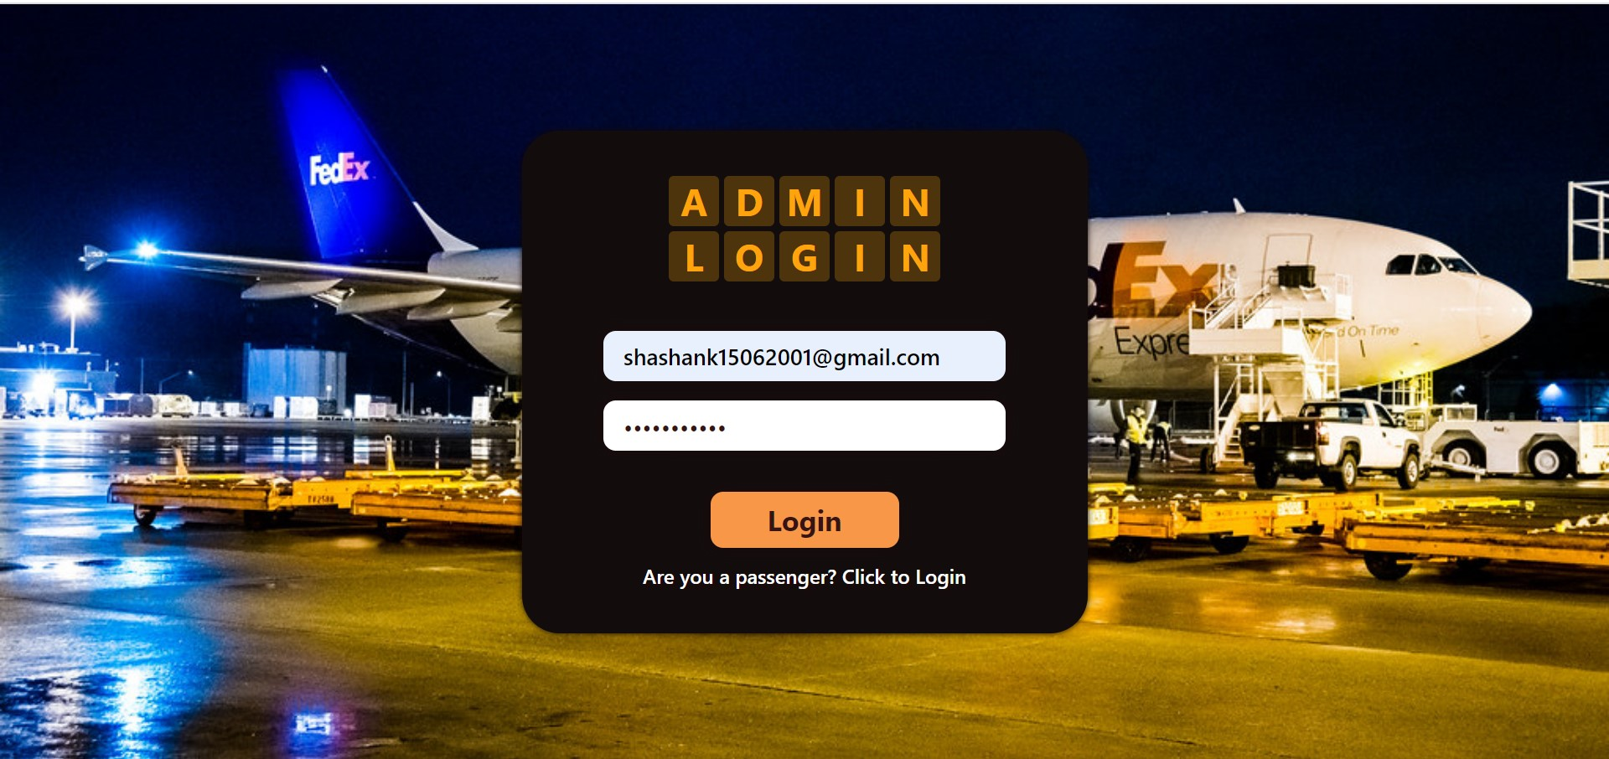
Admin Login

Slide 29
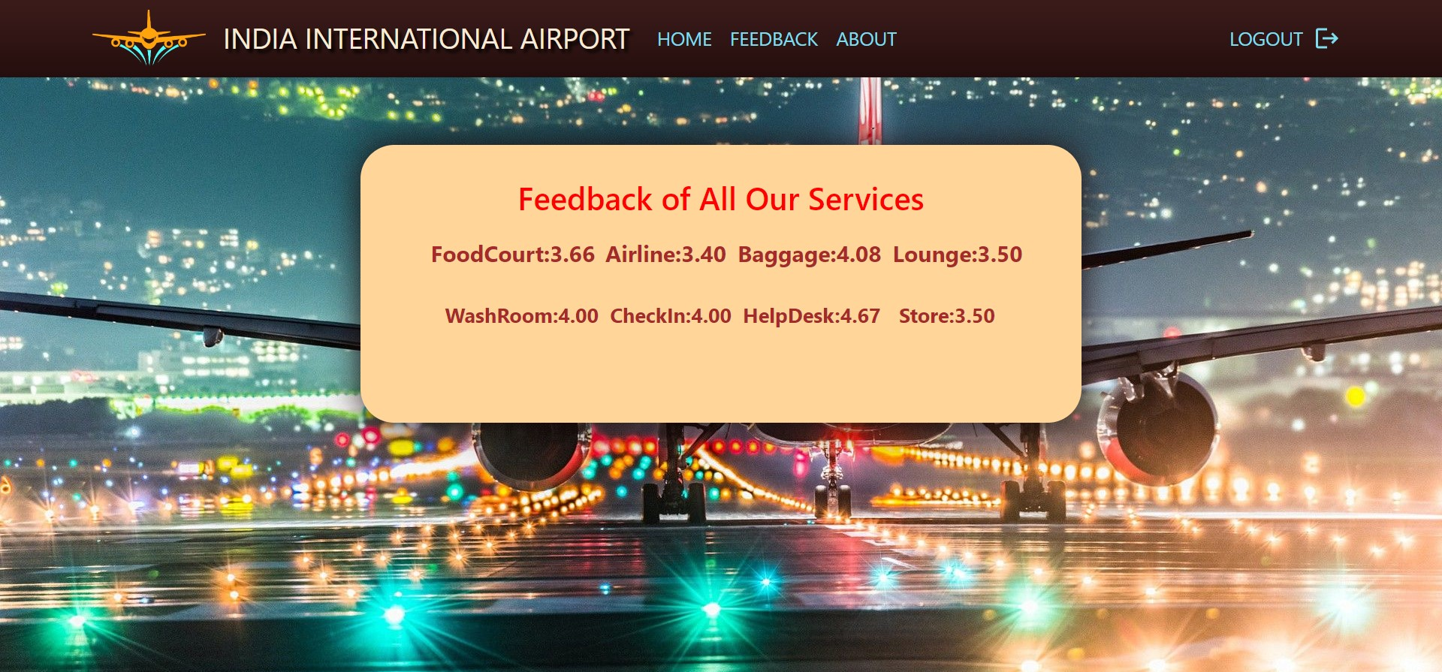
Admin Interface

Slide 30
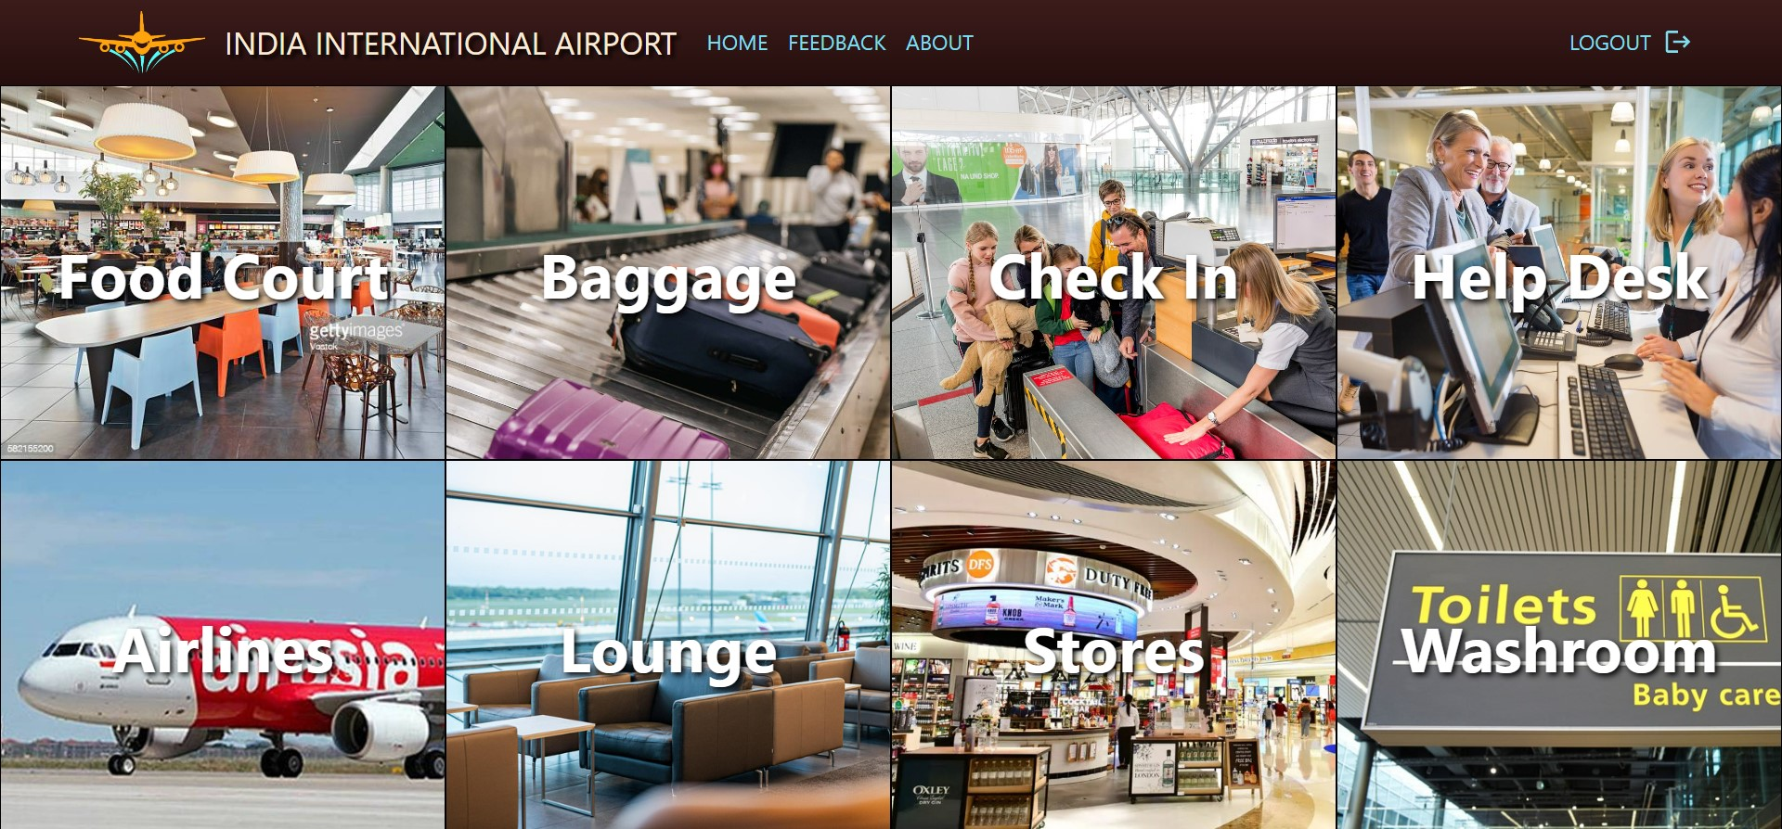
Admin Interface

Slide 31
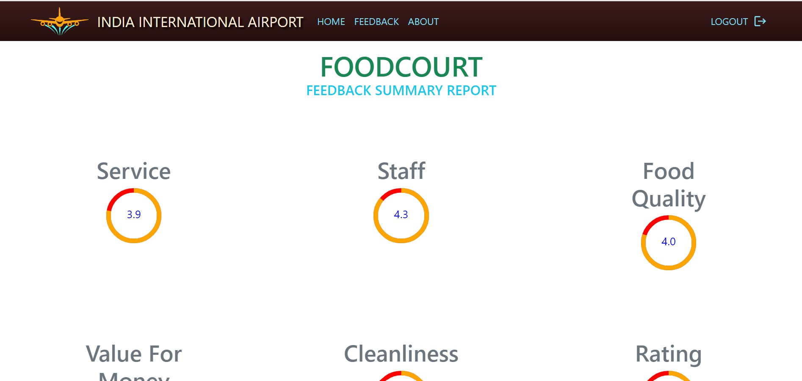
Admin Interface

Slide 32
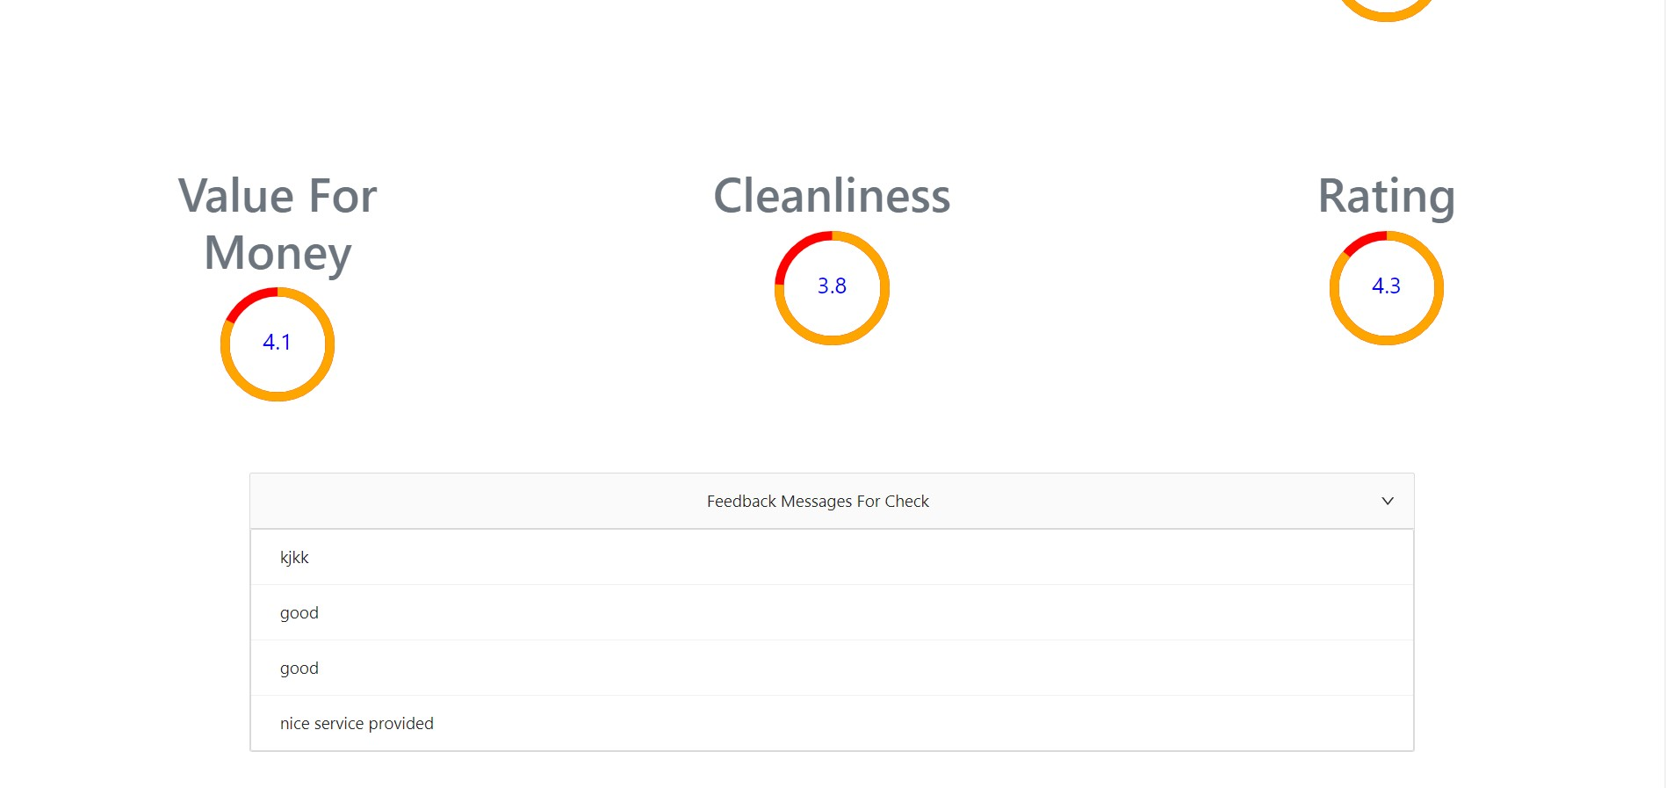
Admin Interface

Slide 33
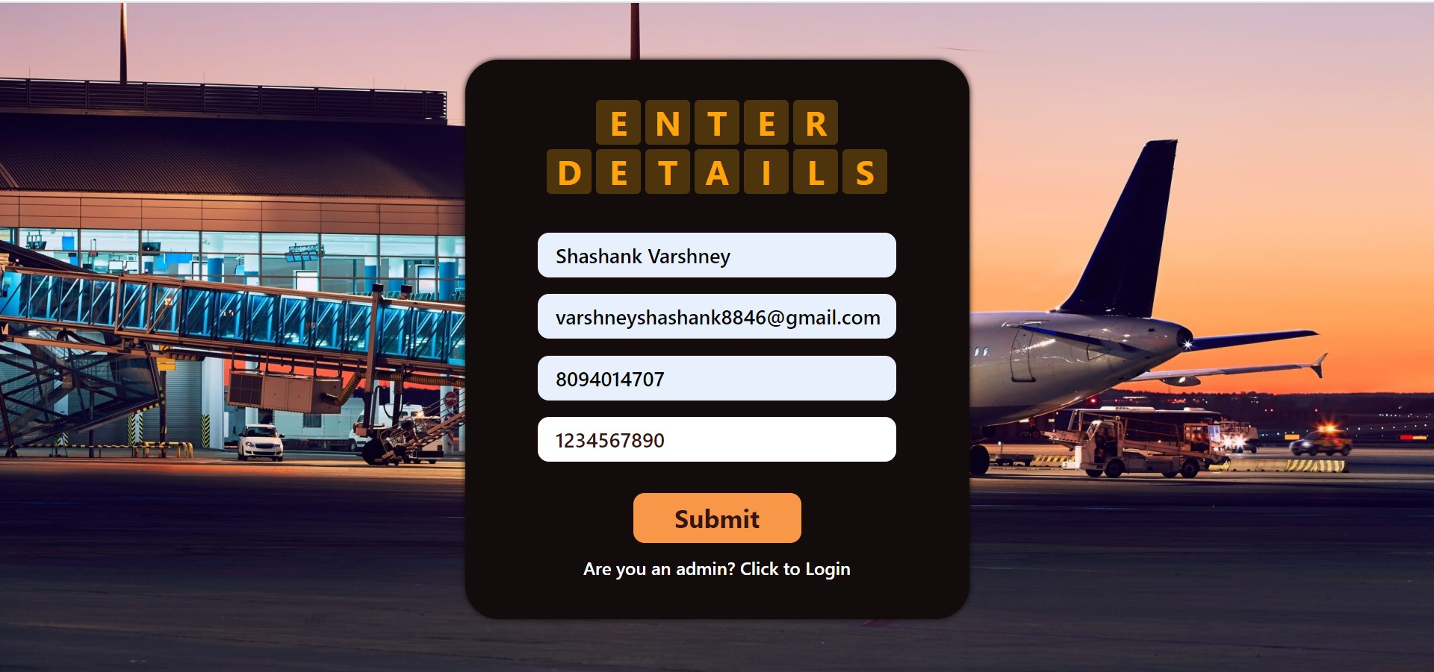
Client Login

Slide 34
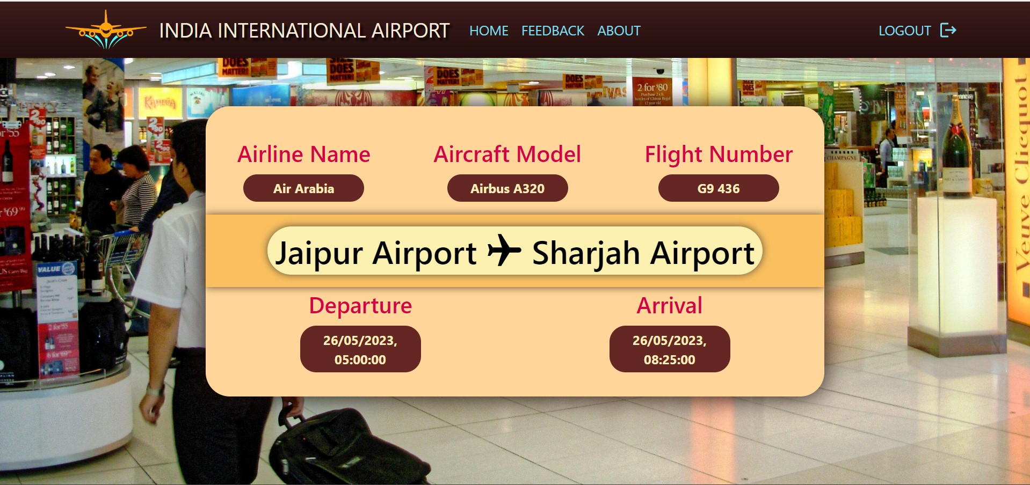
Client Interface

Slide 35

Client Interface

Slide 36
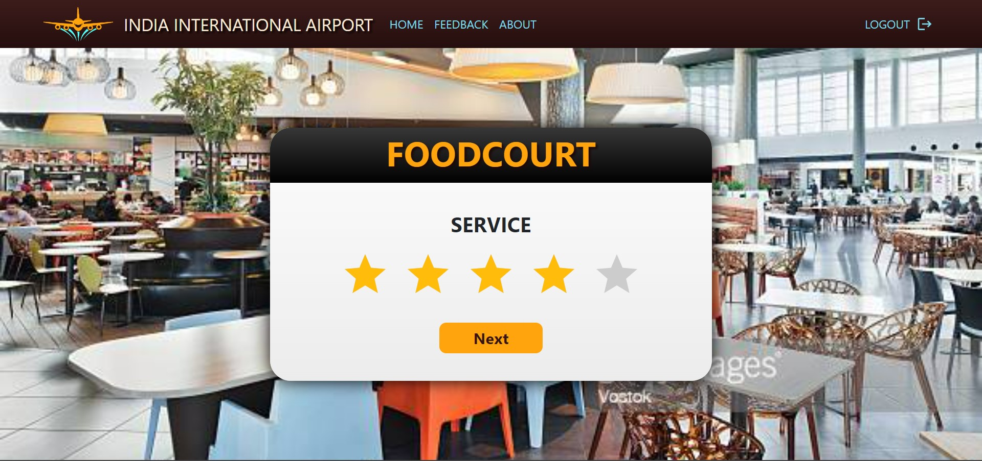
Review Interface

Slide 37
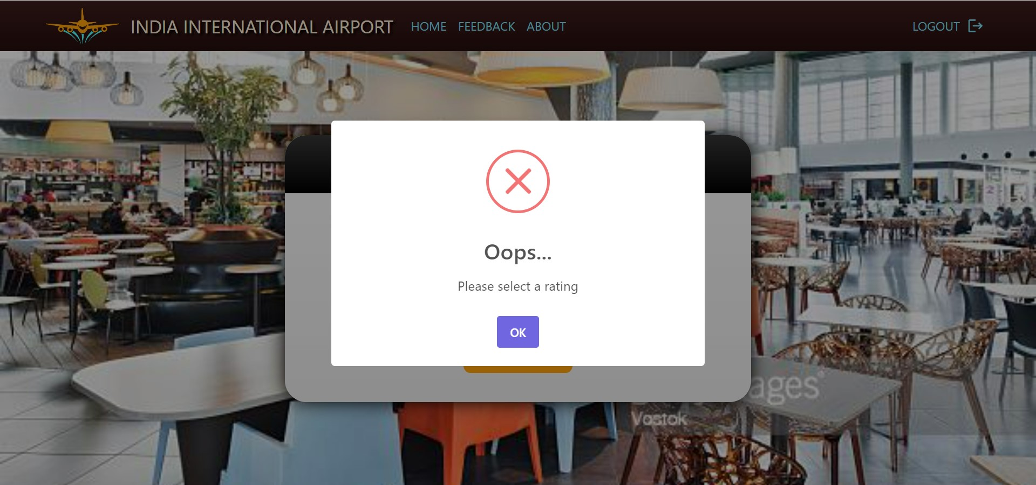
Error Pop-up

Slide 38
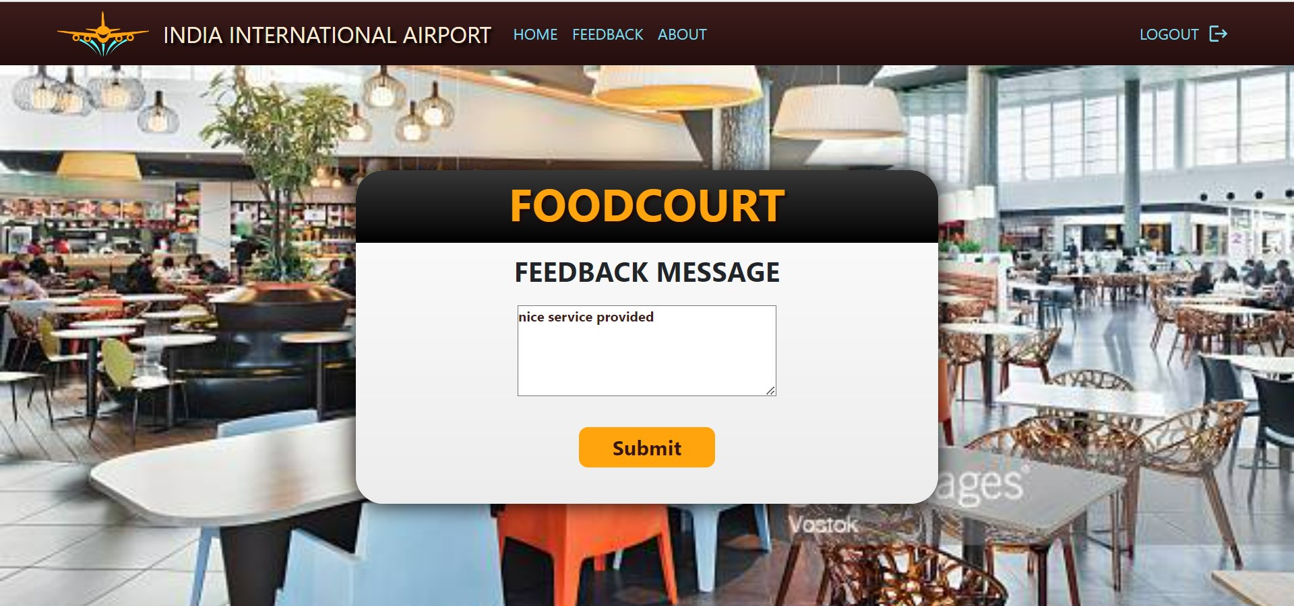
Feedback Message Interface

Slide 39
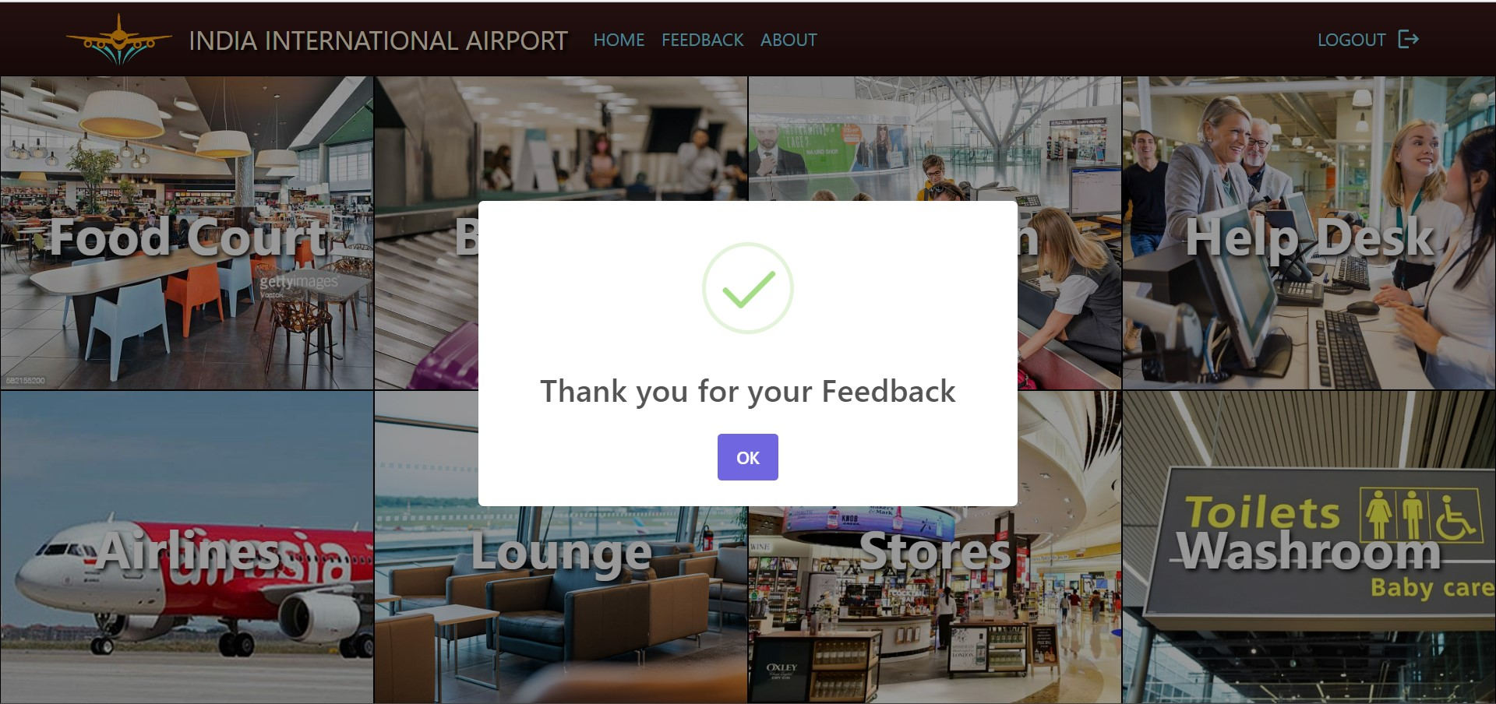
Feedback Submission Pop-up

Slide 40
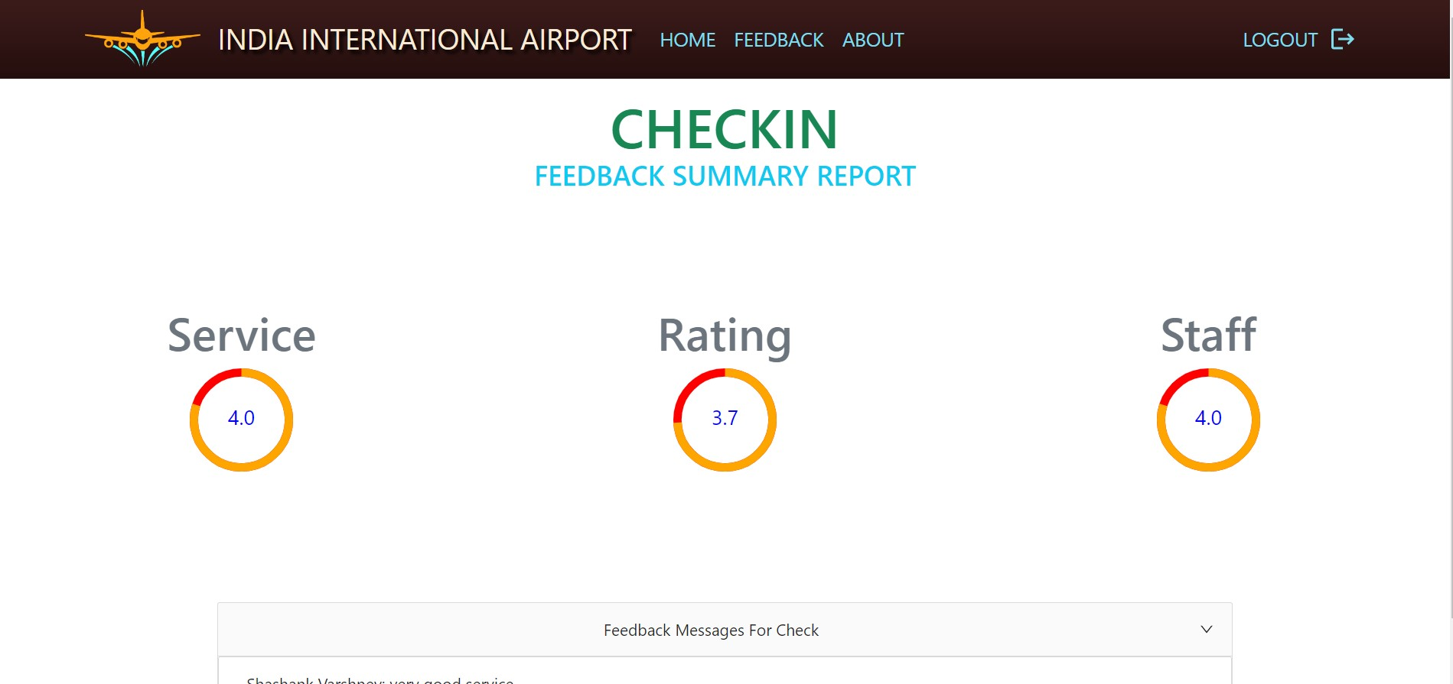
Feedback Summary

Slide 41
Future Scope
The possible future scope of this application will be on mobile platform with following enhancements:
Integrating leave management and attendance system.
Apply machine learning to generate meaningful trends and results.
Integrating complaint system

Slide 42
Refrences
Object Oriented Modeling and Design with UML- Michael Blaha, James Rambaugh.
Software Engineering, Seventh Edition, lan Sommerville.
Wikipedia - www.wikipedia.com
MongoDB - www.mongodb.com
Node.js-www.w3schools.com
Express.js-www.tutorialspoint.com
React.js - www.reactjs.org

